Slide 1
MICROCREDIT DEFAULTER PROJECT
Presented by
Prakash kumar sinha

Slide 2
Introduction
Problem Statement
Problem Understanding
Data Analysis & Modelling Flowchart
Exploratory Data Analysis
Visualizations
Data Analysis Steps Done
Assumptions
Model Building
Conclusion

Slide 3
Introduction
Problem Statement:
A Microfinance Institution (MFI) is an organization that offers financial services to low-income populations. MFS becomes very useful when targeting especially the unbanked poor families living in remote areas with not much sources of income.
They understand the importance of communication and how it effects a person’s life and lack of communication can cause lot of uncertain problems, thus, focusing on providing their services and products to low-income families and poor customers that can help them in the need of hour.

Slide 4
Conceptual Background of the Domain Problem
MFS are collaborating with an MFI to provide micro-credit on mobile balances to be paid back in 5 days. The Consumer is believed to be defaulter if he deviates from the path of paying back the loaned amount within the time duration of 5 days. For the loan amount of 5 (in Indonesian Rupiah), payback amount should be 6 (in Indonesian Rupiah), while, for the loan amount of 10 (in Indonesian Rupiah), the payback amount should be 12 (in Indonesian Rupiah).

Slide 5

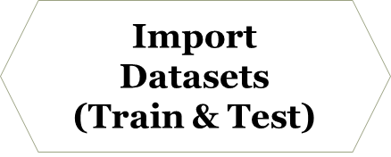












Data Analysis and Model Building Flowchart
Labble
encoding

Slide 6
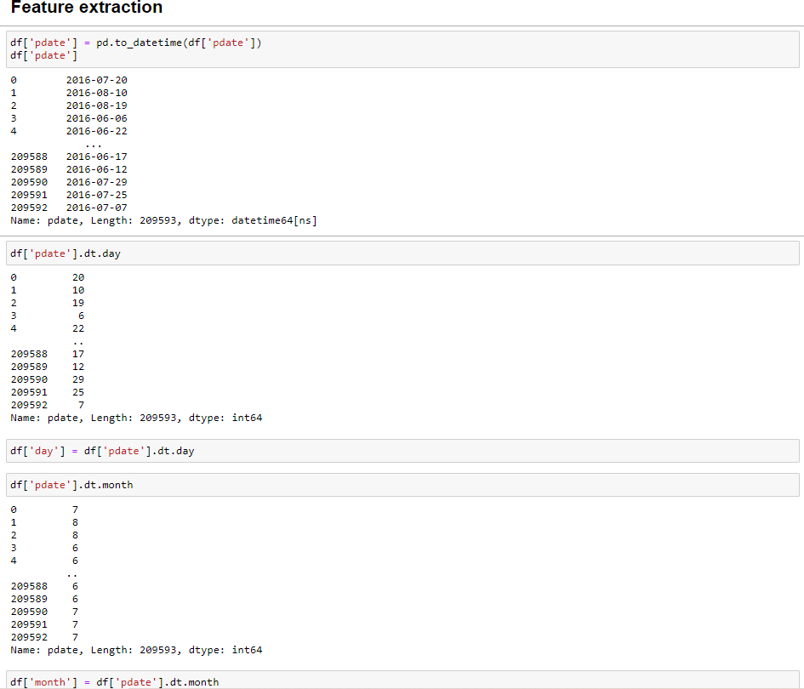
Data Preprocessing Done
We first done data cleaning. In data cleaning we done feature extraction, we extracted the features day and month from pdate column as shown in fig

Slide 7
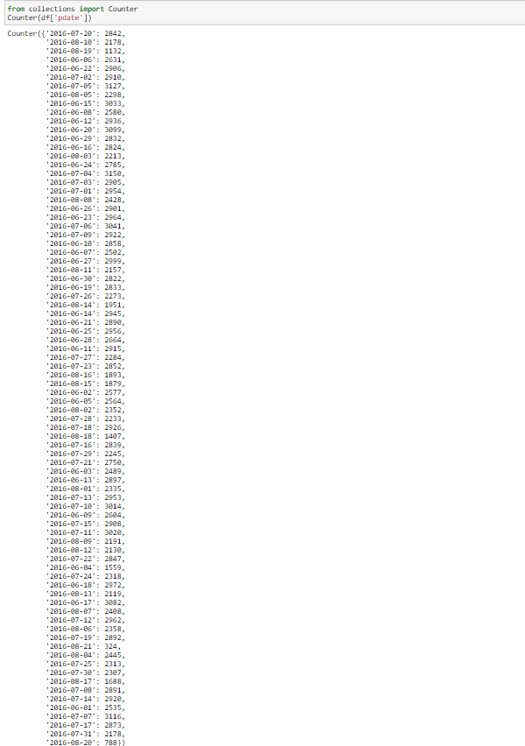
AS we can see we extracted day and month from pdate column, we won’t be needing year as there is only one unique value of year present in the dataset i.e 2016 as shown in fig

Slide 8
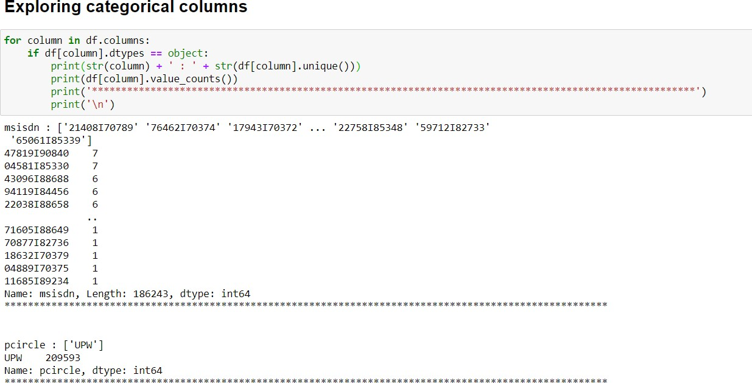
We then explored categorical variables as shown in fig
We observed that there is only one unique value present in pcircle column which is ‘UPW’ so will be dropping this column. Then we observed that column msisdn was present in categorical column so we encode it to numbers using label encoder as shown in fig , to check it’s correlation with other feature variables and target varriable

Slide 9
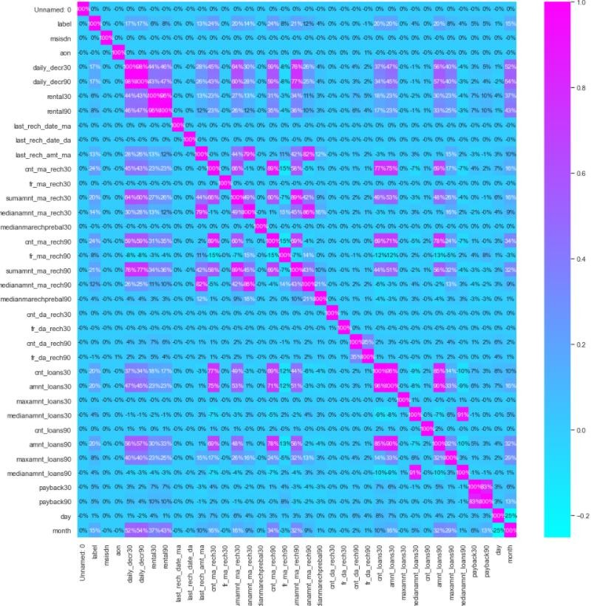
Then we checked the correlation with the help of heat map as shown in fig.

Slide 10
While checking the heatmap of correlation we observed that there exists multicollinearity in between columns.
We also observed that no correlation was present in unnamed: 0, msisdn, last_rechdate_ma, last_rechdate_da columns so we will be dropping these columns.

Slide 11
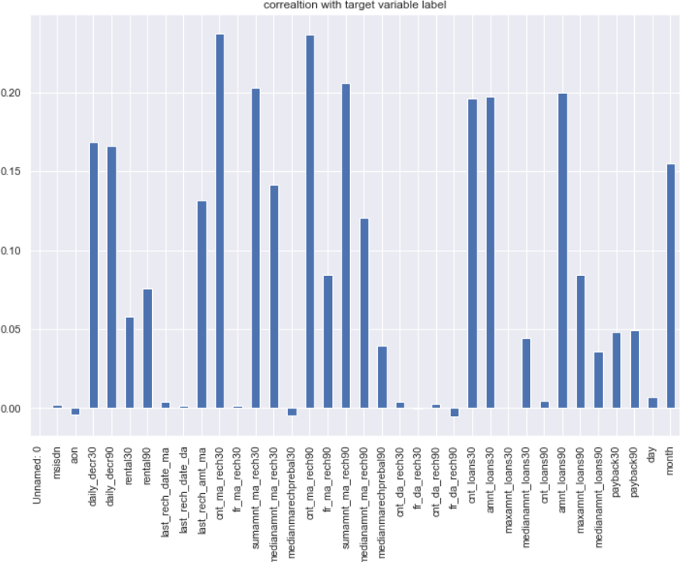
Data Inputs- Logic- Output Relationships
Here we check the correlation between all our feature variables with target variable label as shown in fig

Slide 12
We observe that the columns cnt_ma_rech30 and cnt_ma_rech90 are highly positively correlated with label this means as the cnt_ma_rech30 and cnt_ma_rech90 are increasing the probability of cutomer being non- fraudulent is also increasing.
We also observe that the columns aon, medianmarechprebal30 and fr_da_rech90 are negatively correlated with label this means as the aon, medianmarechprebal30 and fr_da_rech90 are increasing the probability of customer being fraudulent is also increasing.

Slide 13
Hardware and Software Requirements and Tools Used
This project was done on laptop with i5 processor with quad cores and eight threads with 8gb of ram and latest GeForce GTX 1650 GPU on Anaconda, jupyter notebook.
The tools, libraries and packages we used for accomplishing this project are pandas, numpy, matplotlib, seaborn, scipy stats, sklearn.decomposition pca, sklearn standardscaler, collections counter, imblearn SmoteTomek, GridSearchCV, joblib.

Slide 14
Model/s Development and Evaluation
The algorithms we used for the training and testing are as follows: -
Extreme gradient boosting classifier
Decision tree classifier
KNeighbors classifier
Logistic Regression
GaussianNB
Random forest classifier
Ada boost classifier
GradientBoostingClassifier
Bagging classifier
Extra trees classifier

Slide 15
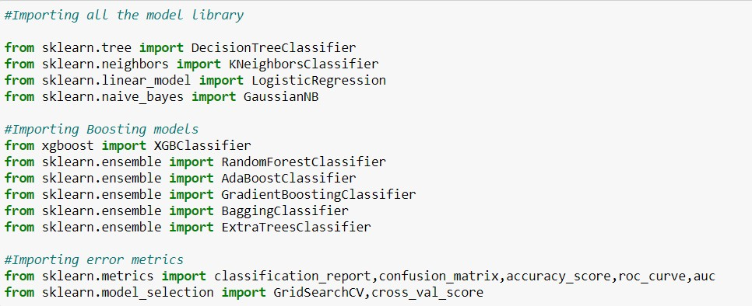
Run and Evaluate selected models
The algorithms we used are shown in fig.

Slide 16
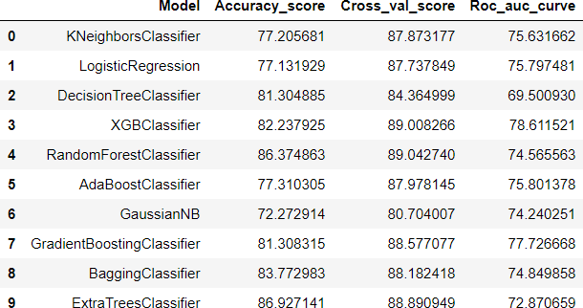
The results observed over different evaluation metrics are shown in fig

Slide 17
Key Metrics for success in solving problem under consideration
Accuracy is not a appropriate measure of model performance here and we used the metric AREA UNDER ROC CURVE to evaluate models performance because high ROC score will mean high recall which means the model does well by not classifying legit transactions as fraudulent.

Slide 18
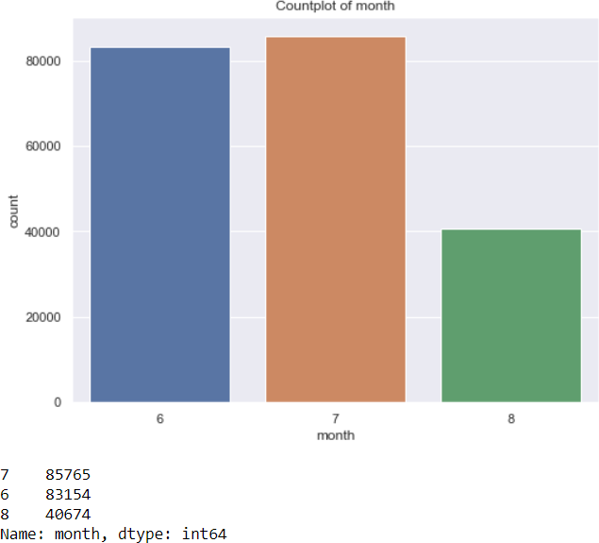
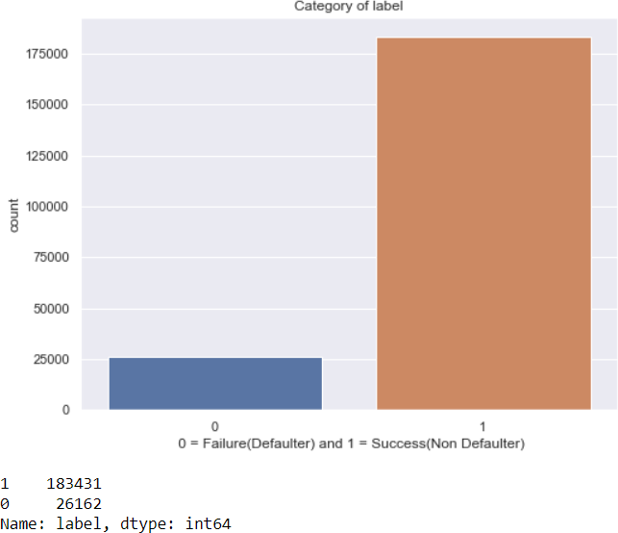
Visualizations
Observation:
We observe 183431 number of Non defaulters where as 26162 number of defaulters.
We observe that this is a very imbalanced data set.
Observations Maximum(85765) number of users has taken credit on 7th month.

Slide 19
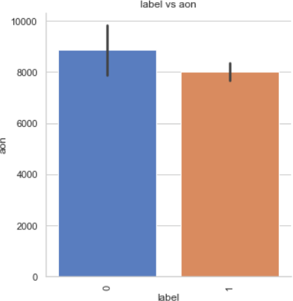
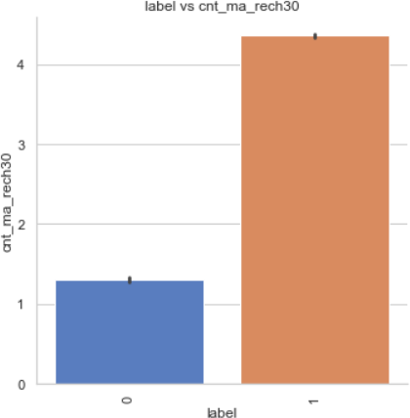
Observation:
If the aon is high the number of defaulters is more.
Observation: If Number of times main account got recharged in last 30 days(cnt_ma_rech30) is more then there is less chance of default.

Slide 20
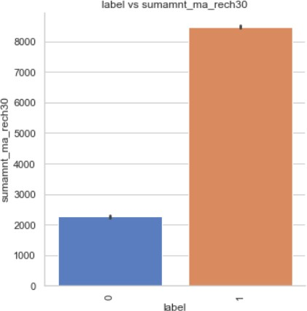
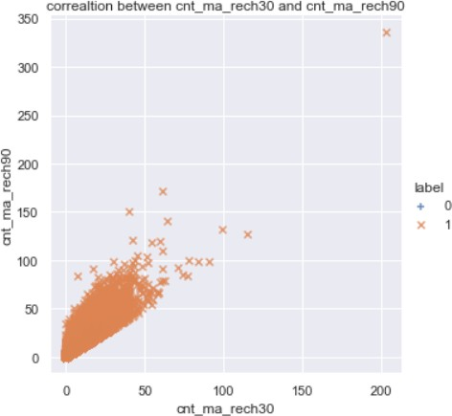
If Total amount of recharge in main account over last 30 days(sumamnt_ma_rech30) is more the chances of default are less.
As cnt_ma_rech30 and cnt_ma_rech90 are increasing the number of non defaulters are also increasing

Slide 21
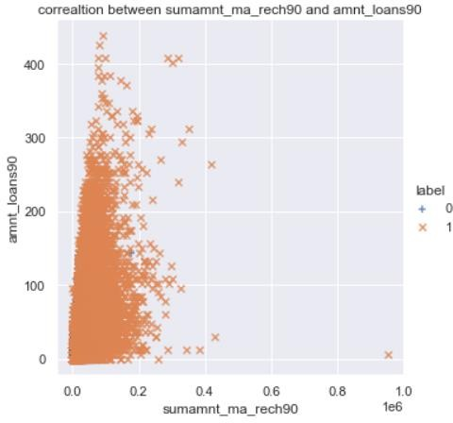
As sumamnt_rech90 and amnt_loans30 are increasing the number of non- defaulters are also increasing.

Slide 22
Interpretation of the Results
From the visualization we interpreted that the data was very imbalanced and the target variable was highly positively correlated with the columns cnt_ma_rech30 and cnt_ma_ma_rech90.
From the preprocessing we interpreted that data was improper scaled, there were hidden features present in the data which needed to be extracted.
From the modeling we interpreted that XGBClassifier works best with respect to our model with rocscore 0.90 as shown in fig 20

Slide 23
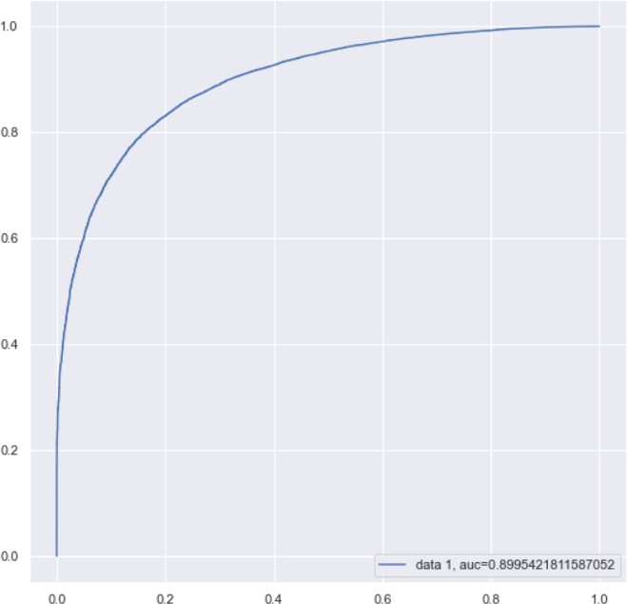

Slide 24
CONCLUSION
Key Findings and Conclusions of the Study
In this project we have tried to show how to deal with unbalanced datasets like the MicroCreditDefaulter where the instances of fraudulent cases is few compared to the instances of non-fraudulent cases. We have argued why accuracy is not a appropriate measure of model performance here and used the metric AREA UNDER ROC CURVE to evaluate how method of SmoteTomek technique can lead to better model training.
The best score of 0.90 was achieved using the best parameters of XGBClassifier through GridSearchCV though both random forest and gradient boosting models performed well too.

Slide 25
THANK YOU

